Slide 1
2. What made this possible?
Past
(best circa
2012)
Early
2015
2.5 years
Today
2017
Progress within
DL methods
DPM
(Pre DL)
Fast R-CNN
(AlexNet)
Fast R-CNN
(VGG-16)
Faster R-CNN
(ResNet-50)
Faster R-CNN
(R-101-FPN)
Mask R-CNN
(X-152-FPN)
Notes:
Now I want to shift gears and discuss some trends in the field of object detection
In particular, since deep learning became effective for deep learning we’ve seen a massive improvement in the application of deep learning techniques
I want to discuss my analysis of what factors have made this possible.

Slide 2
Trend 1: The Unreasonable Effectiveness of Tweaking Hyper-parameters
Embarrassing
COCO box AP
Faster R-CNN w/ VGG-16
original implementation
Faster R-CNN w/ VGG-16
better hyper-parameters
An Implementation of Faster RCNN with Study for Region Sampling. Chen and Gupta. ArXiv 2017.
Notes:
The first is perhaps a bit embarrassing and a bit of a dirty secret
It’s the unreasonable (or embarrassing) effectiveness of tweaking hyper-parameters
Not many people want to talk about this, but I think it’s important that we address it head on and admit that lots of little details often have larger effect sizes than a lot of publications in CVPR
For example, this arxiv posting from Chen and Gupta shows that simplying by optimizing some training hyper-parameters for Faster R-CNN they achieve a pretty sizeable improvement in AP
So for sure a non-trivial amount of this improvement has been simply because our recipes have gotten better

Slide 3
Trend 2: Larger Models
COCO box AP
Mask R-CNN
ResNet-50-FPN
(1x FLOPS)
Mask R-CNN
ResNet-101-FPN
(1.9x FLOPS)
Mask R-CNN
ResNeXt-101-64x4d-FPN
(3.8x FLOPS)
Notes:
The second trend is that of larger models
Here’s a comparison of three Mask R-CNN with three different backbone networks: ResNet-50, ResNet-101 and a ResNeXt-101
As you can see there are steady gains from these improved backbone models

Slide 4
(Future?) Trend 3: More Data / Pretraining
COCO box AP
Mask R-CNN
ResNet-50-FPN
ImageNet-1k pretraining
Mask R-CNN
ResNet-101-FPN
ImageNet-1k pretraining
Mask R-CNN
ResNeXt-101-64x4d-FPN
ImageNet-1k pretraining
Mask R-CNN
ResNeXt-101-64x4d-FPN
ImageNet-5k pretraining
(5x pretraining data)
Notes:
The third one is actually not a trend yet, but I think will be in the near future and that’s using more data
This has been largely unexplored over the last several year, but shows some promising signal
For example, by increasing the amount of imagenet pretraining data from 1.2M to 6M images, AP on COCO improves even without having more detection training data

Slide 5
Trend 4: Domain Specific Knowledge
Region Proposal Network (RPN) vs. direct regression (e.g., YOLO v1)
Feature Pyramid Network (FPN)
vs. using a single feature scale
RoIAlign
vs. RoIPool
Caveat: we’ve observed diminishing returns in some cases when using larger models (e.g., deformable RoIAlign and squeeze-excitation context showed improvements on R-50 that vanished on X-101)
Dai et al. Deformable Convolutional Networks. ICCV 2017.
Hu, Shen, Sun. Squeeze-and-Excitation Networks. ArXiv 2017.
Notes:
Finally, the last trend is the success of incorporating domain knowledge
In the hype of deep learning, people often overlook the fact that at the end of the day we’re still building big, complex models by hand
While this may some day be replaced by learned models structure, thus far we’ve covered a lot of ground by bringing domain specific insight into the model structure
There is a caveat, however…

Slide 6
3a. How good is this?
Past
(best circa
2012)
Early
2015
Today
2017
DPM
(Pre DL)
Fast R-CNN
(AlexNet)
Fast R-CNN
(VGG-16)
Faster R-CNN
(ResNet-50)
Faster R-CNN
(R-101-FPN)
Mask R-CNN
(X-152-FPN)
Notes:
Now let’s look at how good these results really are…
I think we’ve done ourselves a disservice in recent times
In the old days of object detection, we would show some good results and not worry because everyone understand that the methods did really work
We continue to do that today, but now people are starting to think that these methods work all of the time
Now don’t get me wrong, the results are frequently quite impressive, but the following examples show just how badly these systems still fail

Slide 7
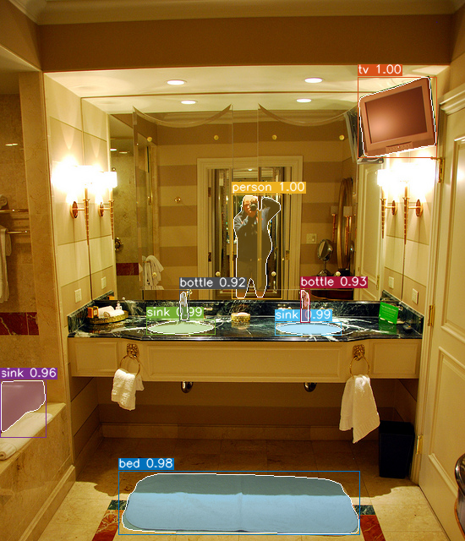
Notes:
Bed, really? Sink?

Slide 8
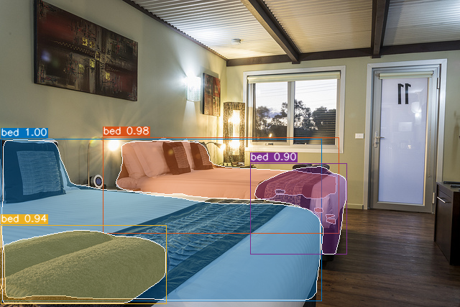
Notes:
Beds on beds on beds?

Slide 9
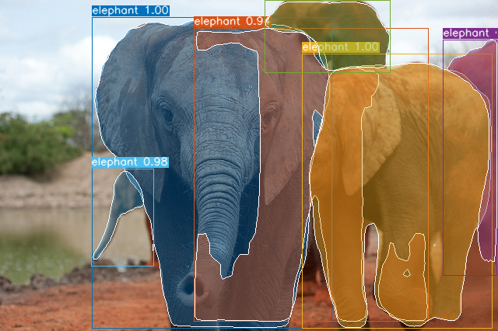
Notes:
Failure to parse overlapping elephants

Slide 10
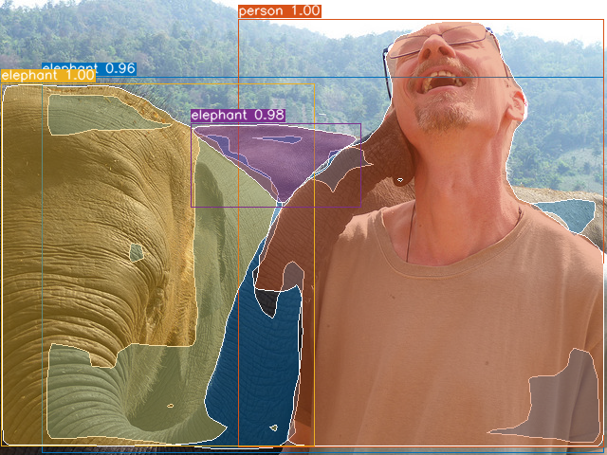
Notes:
And again

Slide 11
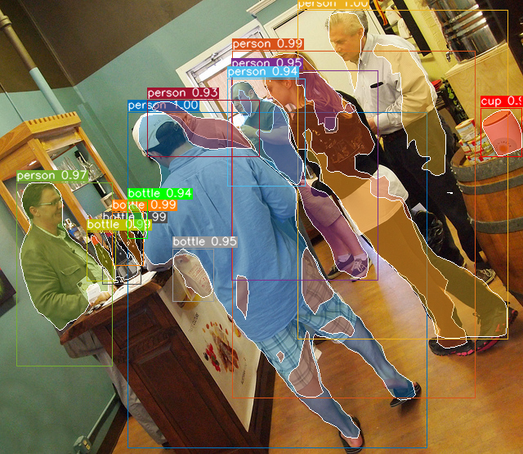
Notes:
Rotate and fail

Slide 12
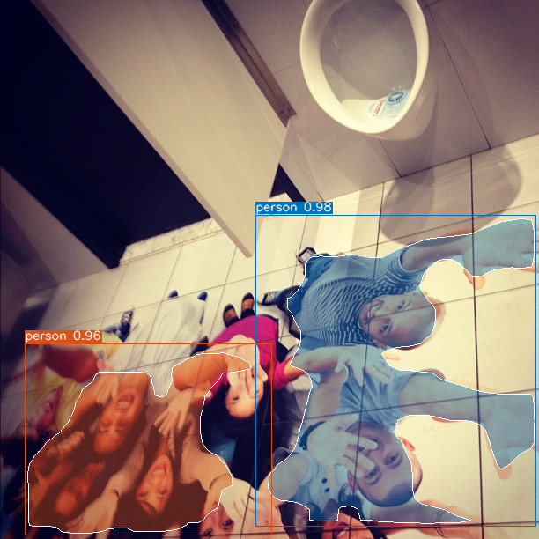
Notes:
Nice try

Slide 13
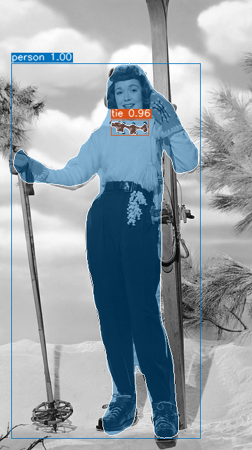
Notes:
Revenge of context

Slide 14
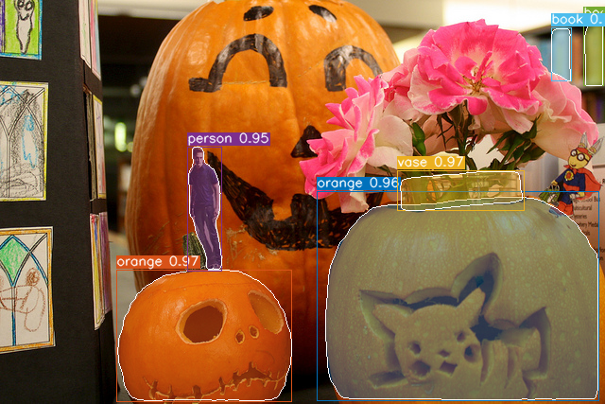
Notes:
Pumpkins are the new orange

Slide 15
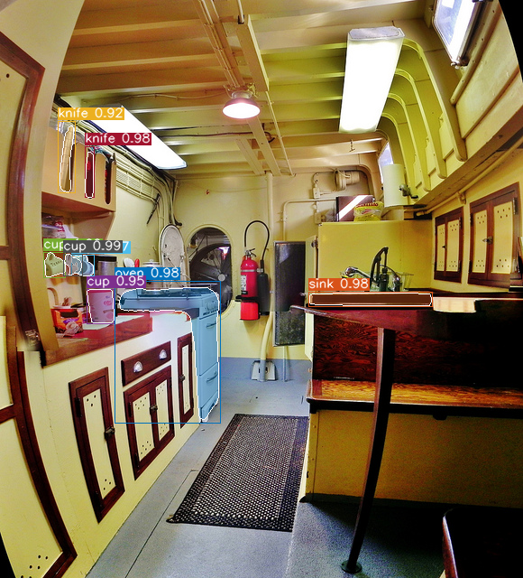
Notes:
Nice try knives

Slide 16
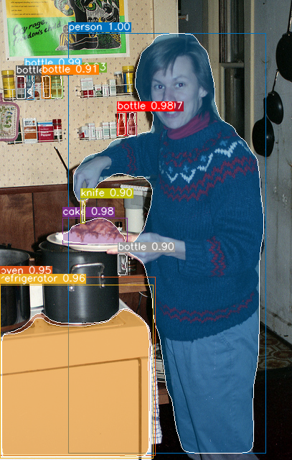
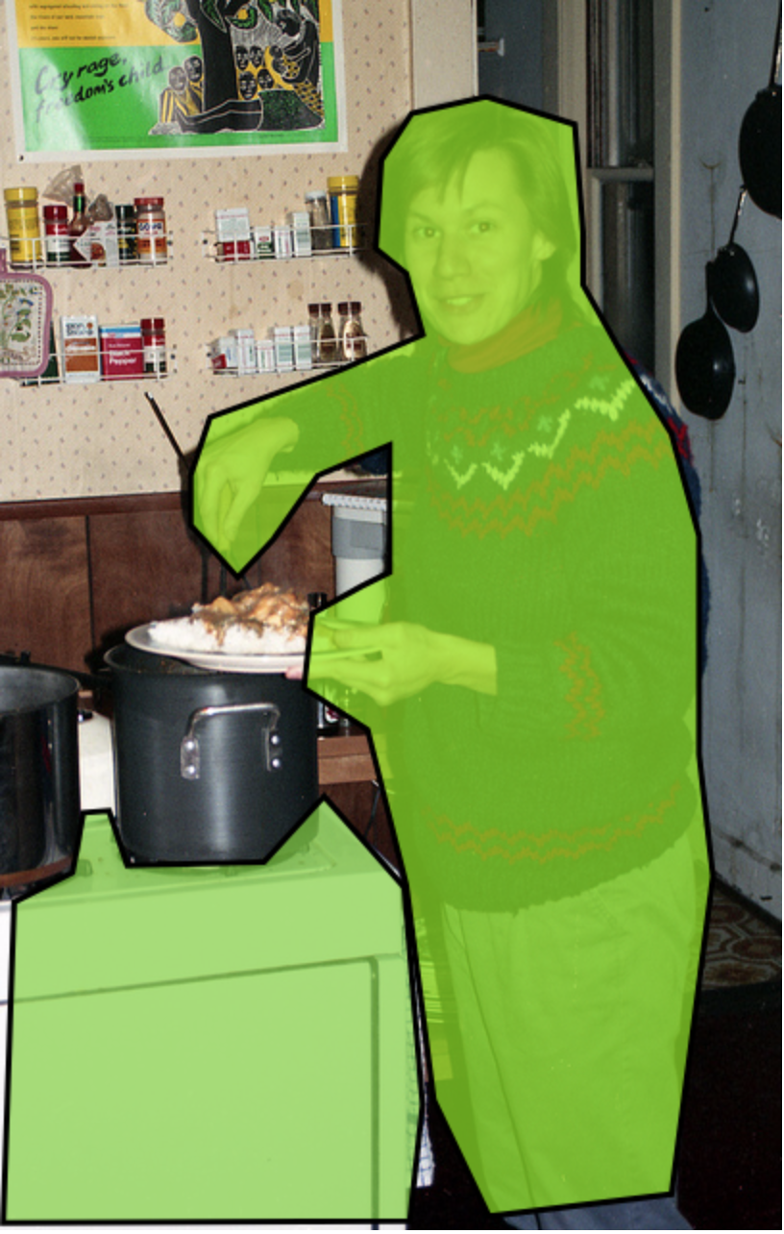
Notes:
Stew cake?

Slide 17
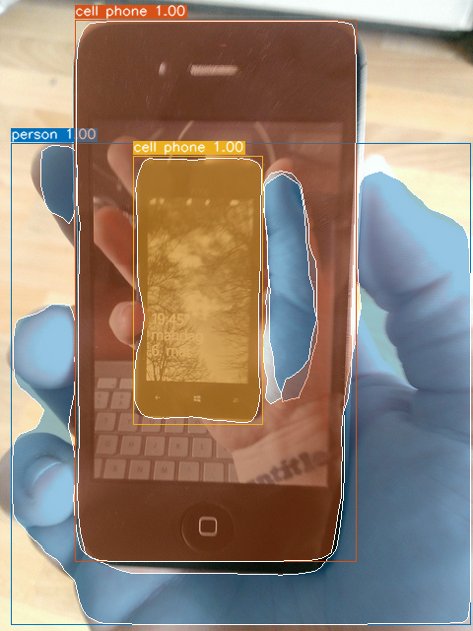
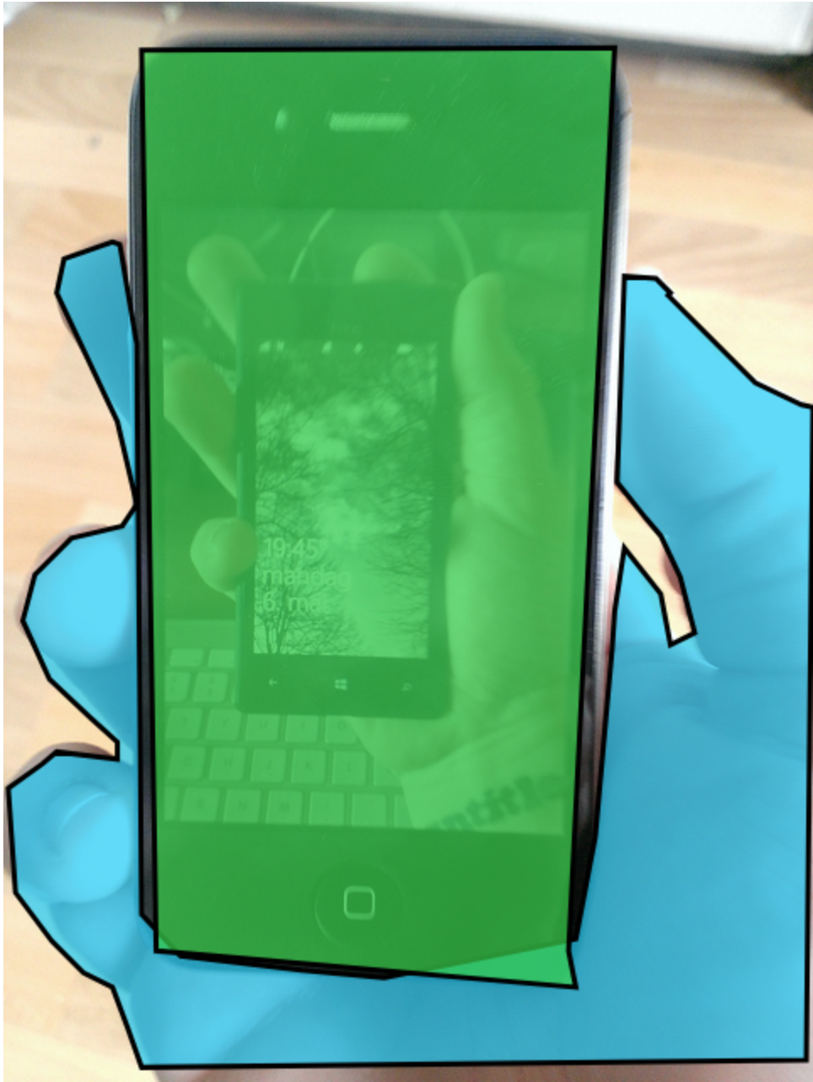

Slide 18
Is Object Detection Solved?
Obviously no; there are frequently silly errors
But it is getting frustratingly good
The errors are often reasonable
The bottlenecks are raw recognition and “reasoning”
Notes:
So is it really solved? I don’t think so
But it is getting really good in a lot of cases and the errors are often quite reasonable

Slide 19
3b. What’s next?
Past
(best circa
2012)
Early
2015
Today
2017
?
DPM
(Pre DL)
Fast R-CNN
(AlexNet)
Fast R-CNN
(VGG-16)
Faster R-CNN
(ResNet-50)
Faster R-CNN
(R-101-FPN)
Mask R-CNN
(X-152-FPN)
Notes:
Finally, I’ll conclude with a few thoughts on what’s next for object detection research
I’ll offer three paths, not mutually exclusive

Slide 20
Path 1: Continue what we’re doing
Scale training data and model complexity – largely unexplored
Intentional human labeling cannot scale
Try to invent new domain specific improvements (see caveat)

Slide 21
Path 2: Define new Detection Problems
E.g., from box prediction to mask prediction
Current favorite: scale Mask R-CNN from 100 to 10,000 categories
Challenges:
The end of categories? (ask Alyosha)
Evaluation, evaluation, evaluation
Training data; we’ll never have COCO for 10,000 categories
Learning from very few examples
Learning from weakly labeled data

Slide 22
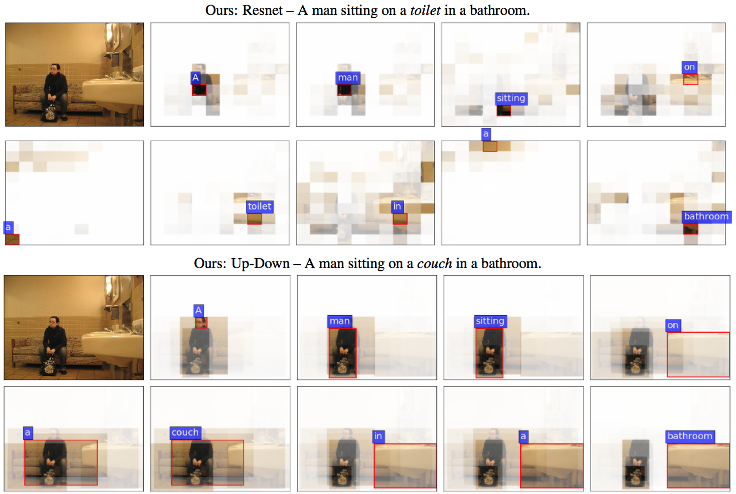
Path 3: Object Detector as a Module
Pretend that object detection is solved
Use the object detector as a module in a larger system
For example, in VQA
Anderson et al. Bottom-Up and Top-Down Attention for Image
Captioning and Visual Question Answering. ArXiv 2017.

Slide 23
Thanks for your attention!
Past
(best circa
2012)
Early
2015
Today
2017
?
DPM
(Pre DL)
Fast R-CNN
(AlexNet)
Fast R-CNN
(VGG-16)
Faster R-CNN
(ResNet-50)
Faster R-CNN
(R-101-FPN)
Mask R-CNN
(X-152-FPN)
Notes:
Finally, I’ll conclude with a few thoughts on what’s next for object detection research
I’ll offer three paths, not mutually exclusive

Slide 24
Question for Focal Loss for Dense Object Detection
1. Since using the focal loss, RetinaNet is able to reach the speed of previous one-stage detectors and surpass the accuracy of existing two-stage detectors, are there any draw backs for this method? or can we directly replace previous method with this method now?
2. How will focal loss work with other loss formulations like L2 in place of sigmoid cross entropy?
3. Two-stage detectors as often found better than one-stage detectors, but is there any work done on finding the optimal n-shaped detectors?
General Question for Speakers
1. Could you talk about how the research at Facebook AI is integrated into the platform itself (how fast is the turnaround, how much research remains unpublished, how eager are engineers to integrate new advances, what does Zuckerberg think, etc... )?
2.What's the current research direction towards real-time object segmentation?
3.What is the biggest challenge for object detection/image captioning?

Slide 25
Question for Mask R-CNN
1. Why mask R-CNN has better results, since the ground truth of the masks should be unknown? Do you provide extra supervision for the masks?
2. Do you have an intuitive or mathematical explanation for why decoupling mask and class prediction produces better results?
3. What is the explanation for the unreasonable effectiveness of RoIAlign?

Slide 26
Question for Bottom-Up and Top-Down Attention for Image Captioning and Visual Question Answering
1. Is there a neural architecture that might be better than LSTMs for the captioning use case?
2. MSCOCO is an industry standard dataset for captioning, but what other dataset benchmarks along these lines exist? Is MSCOCO overused?
3. Why do you include both previously generated word and the previous state for the Language LSTM as the input of the Top-Down Attention LSTM? Are these types of information mostly similar?

Slide 27
Question for Feature Pyramid Networks for Object Detection
1. It seems like FPNs could be extended to the NLP domain due to they hierarchical nature in which it parses the input. Do you see any immediate reasons why it wouldn't work for tasks such as Q&A?
2. What other domains do you believe could benefit from pyramid networks?
3. What are some limitations to the FPN?

Slide 28
Question for Focal Loss for Dense Object Detection
1. Since using the focal loss, RetinaNet is able to reach the speed of previous one-stage detectors and surpass the accuracy of existing two-stage detectors, are there any draw backs for this method? or can we directly replace previous method with this method now?
2. How will focal loss work with other loss formulations like L2 in place of sigmoid cross entropy?
3. Two-stage detectors as often found better than one-stage detectors, but is there any work done on finding the optimal n-shaped detectors?

